Slide 1
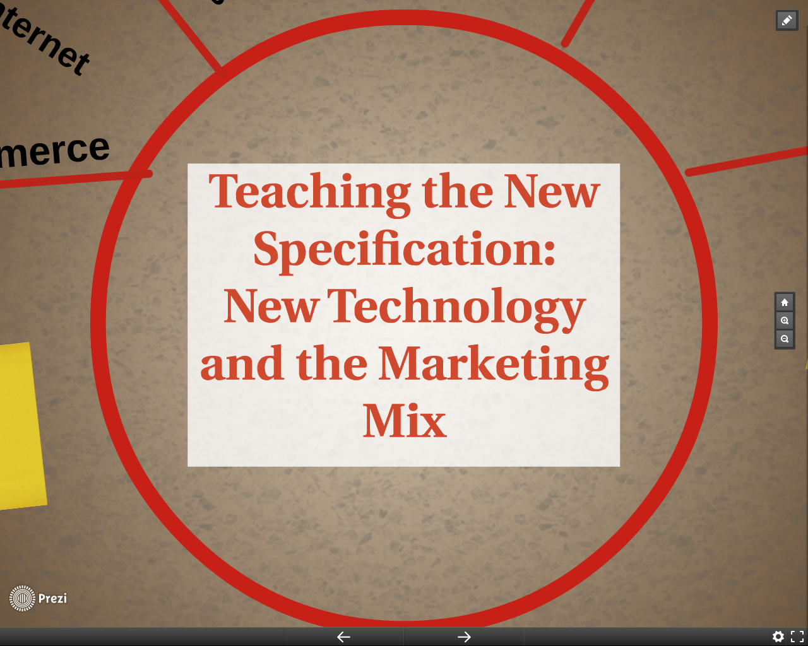

Slide 2
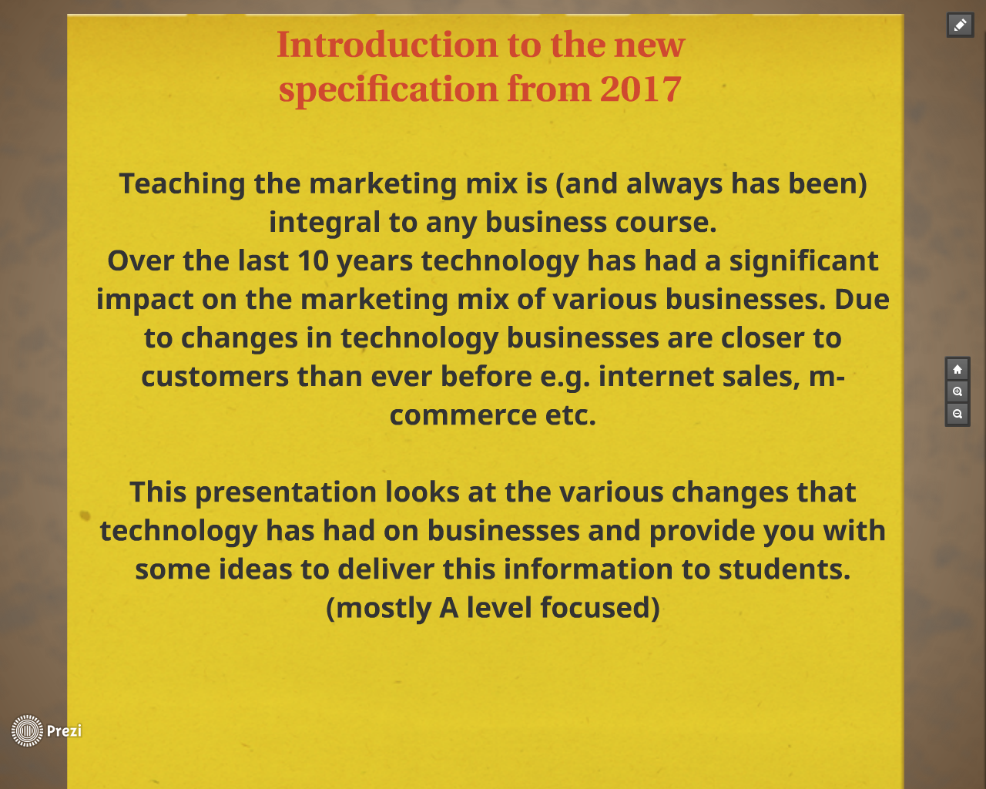
Notes:
For example in a lot of the new b specs there is an expectation to teach the following sections which I will talk about throughout this presentation and how we can incorporate these with new technology.

Slide 3


Slide 4


Slide 5


Slide 6
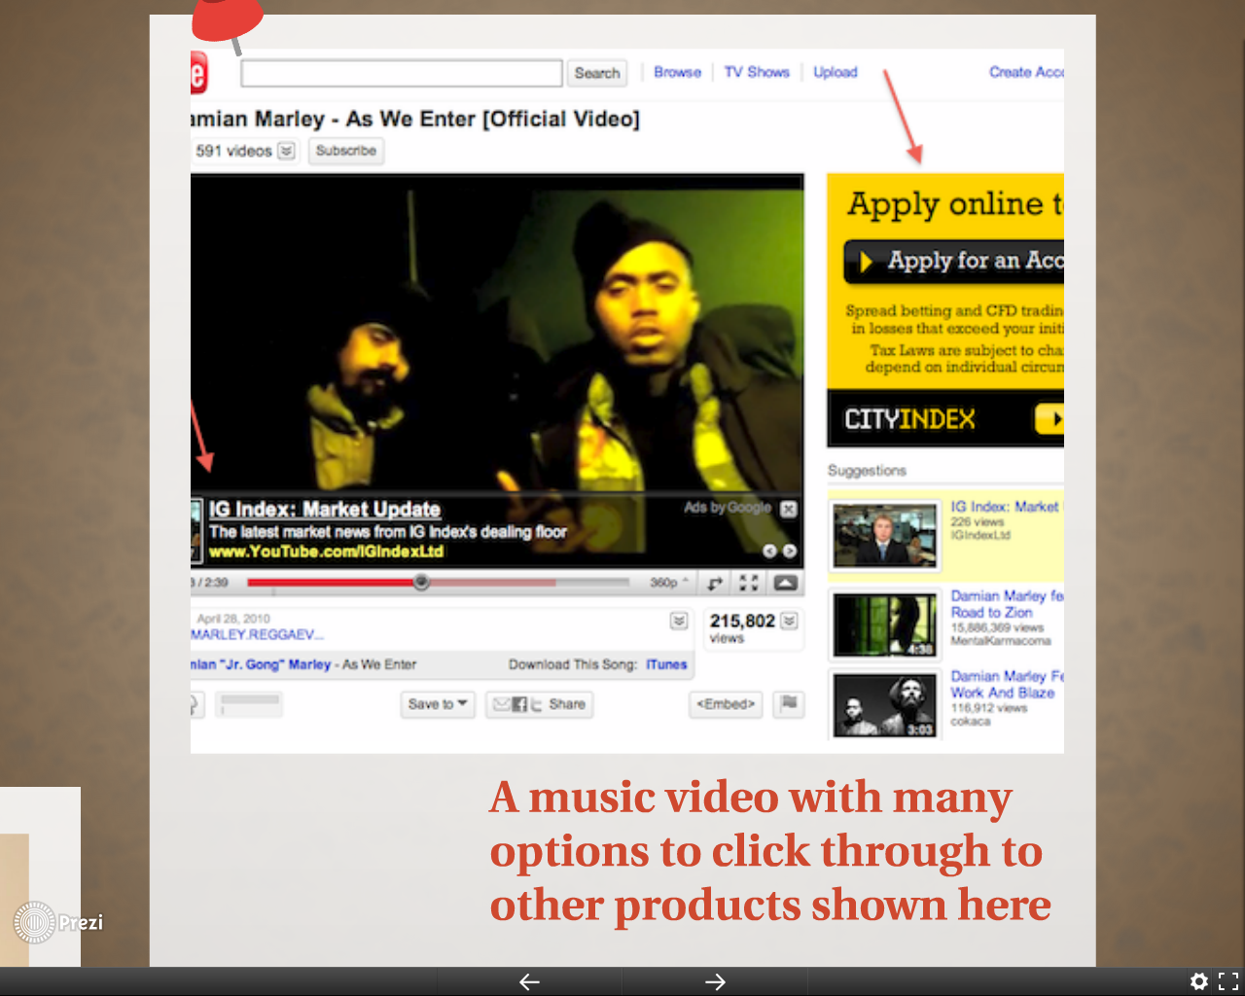

Slide 7

Students can work collaboratively to perform a research task on the top ten you tubers, they make a grid of names, find out how many clicks per hour, day , week and month they and generate their profit www.youtubemoney.co to find out how much money is generated per click
Students work in pairs given one of the 8 benefits of using you tube for marketing : Traffic, google ad words, content presence, ad sense, worldwide audience, you tube email, audience promotion, (taken from the website : www.wearegrow.com/8-massive-benefits-of-using-youtube-for-business on sugar paper, students will create detailed mind maps on their chosen benefit which can be displayed in the classroom.
Record a video and post on social media, see how far it can be shared in 24 hours/ a week and show the students the results!

Slide 8


Slide 9
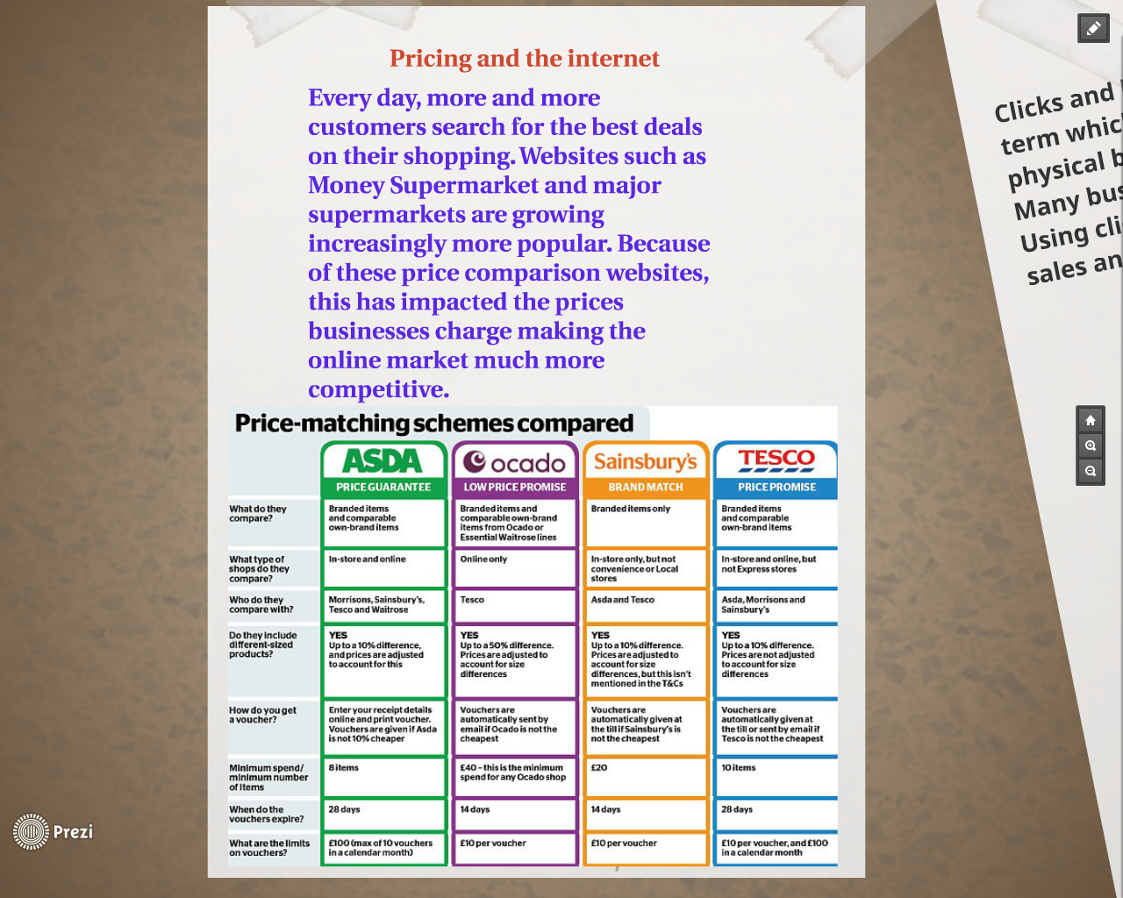

Slide 10
Give students a case study to work on either in teams or individually, i.e give them a supermarket/shop each and find out about price match policy and present information back to the class
Set a series of online questions about pricing and the internet using www.padlet.com or www.socrative.com meaning the students can interact and share thoughts. Praise for the best answers
Use of real life pricing in a competitive market watching you tube videos

Slide 11


Slide 12
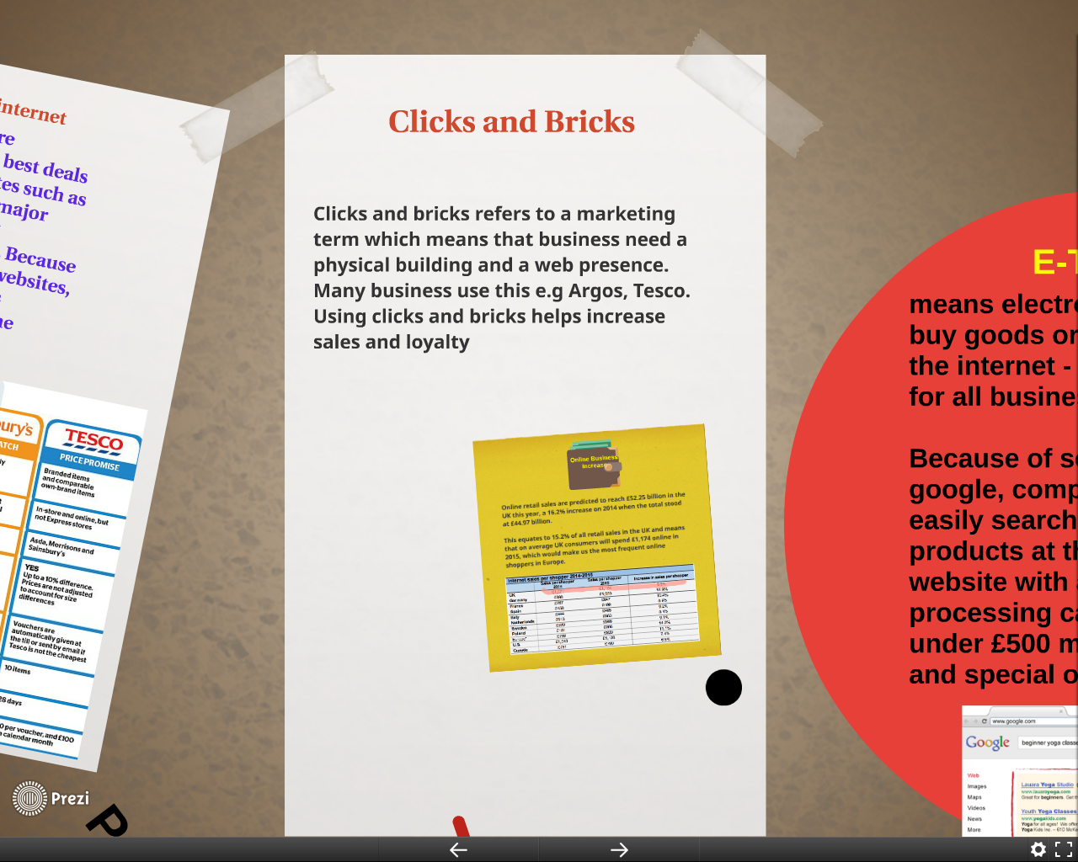

Slide 13
Students make a list of all the shops that have online presence and the ones that dont, find out their worth and compile a top 5 – feedback to class or partner.
Watch and study the real life example of a business man using clicks and bricks in his company www.edp24.co.uk/business/combining_clicks_with_bricks_is_next_stage_of_journey_for_thetford_business_1_4052218. Create a timeline if his events to show the grow of his company.

Slide 14


Slide 15
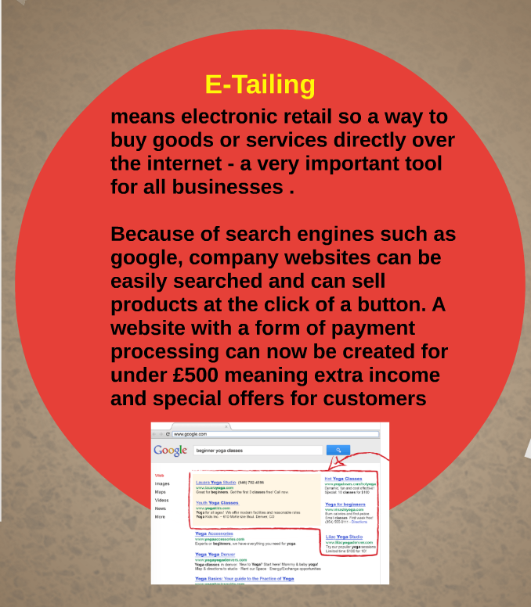

Slide 16
Simple a understandable video link to e-tailing www.youtube.com/watch?v=F1j0At0gyxM
Complete the e tailing worksheet in pairs, use one person as the driver and one as the navigator! e-tailing.doc

Slide 17


Slide 18
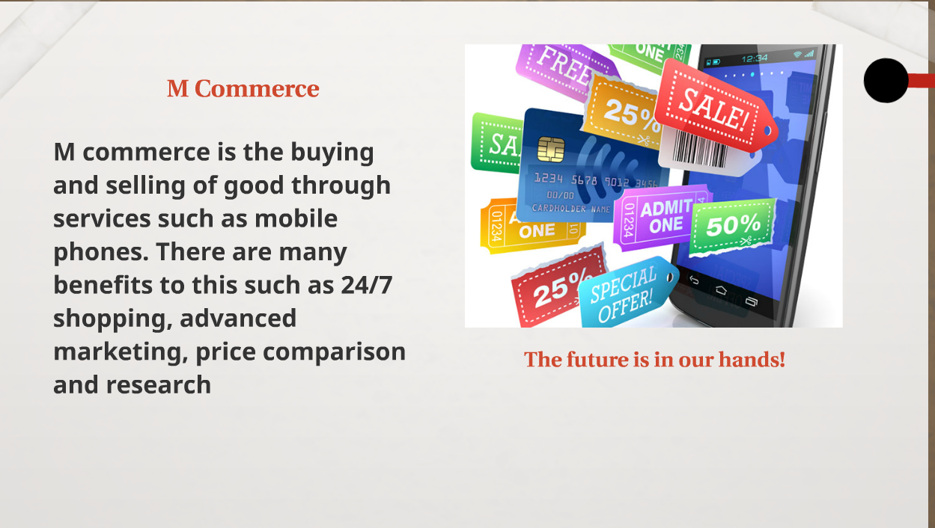

Slide 19
Class Debate: One side of the room FOR E-Commerce, The other side AGAINST. Give them some time to gather evidence.
Sides must take it in turns to select one member come out to the front in the hot seat and argue their point, other teams must then take their turn. The person with the strongest argument for their team wins a point … points make rewards!

