Slide 1
Dr Jacek Brant
What’s wrong with Secondary School economics and how teachers can make it right:
Methodological Critique and Pedagogical Possibilities

Slide 2
What’s my talk about?
Methodology of Economics
School economics
An alternative approach to theory-led teaching
My paper is published in the
Journal of Social Science Education Volume 14, Number 4, Winter 2015

Slide 3

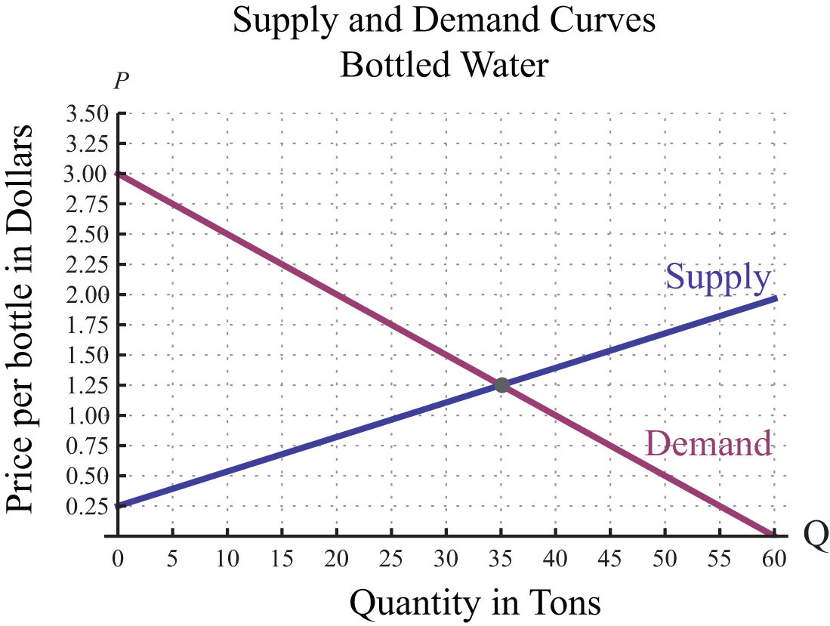
What’s going on here? Your assumptions?
Alternatively, you may use an image slide with text overlaid or a slide with an image and no text
Price
Dr Jacek Brant

Slide 4
Economics popularity in England, Wales & NI
Zenith → nadir → revival
Summer entries
 | 1990s | 2004 | 2015
A2 | C. 30000 | 17762 | 27576
AS |  | 21076 | 46245
Why crisis in economics education? Too hard? Substitution to business studies? Not relevant to young people? Lacking values/moral purpose?

Slide 5
Relevance of school economics?
Neo-classical economics (with a smattering of Keynes)
Orthodoxy is flawed and based on an out-dated paradigm with school economics taught as value-free, positive subject
Theories are accepted as facts (and taught that way)
Unintended consequence: study of economics makes students become more selfish, negative impact on society

Slide 6
‘Scientific’ model of research
The problem is formally presented
A hypothesis is offered
Experiments are created to test the hypothesis
Results of the experiments are predicted
The experiment is observed and results noted
Conclusions are made
Universal laws are surmised
Can economist set up similar experiments?

Slide 7
EXPERT FORECASTS
OIL EXPERT CONSENSUS FORECASTS
100
1981
80
1984
60
US('90)/bbl
1987
40
1990
1993
20
0
1970
1980
1990
2000
2010
2020

Slide 8
School economics, DfE requirement
Develop an interest in and enthusiasm for the study of the subject
Appreciate the contribution of economics to the understanding of the wider economic and social environment
Develop an understanding of a range of concepts and an ability to use these concepts in a variety of different contexts
Use an enquiring, critical and thoughtful approach to the study of economics and an ability to think as an economist
Understand that economic behaviour can be studied from a range of perspectives
Develop analytical and quantitative skills, together with qualities and attitudes which will equip them for the challenges, opportunities and responsibilities of adult and working life

Slide 9
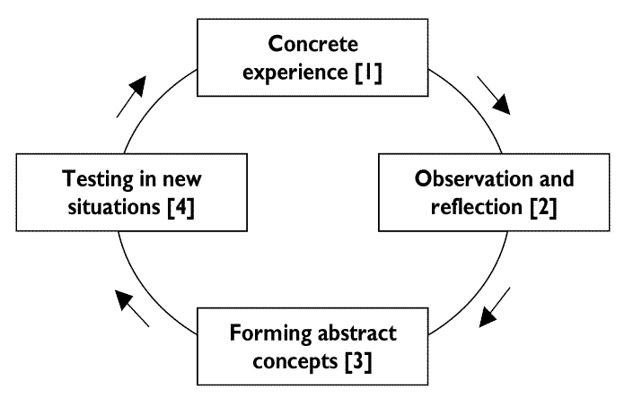
Kolb’s learning cycle

Slide 10
Let’s revisit our trusted S+D diagram…
Alternatively, you may use an image slide with text overlaid or a slide with an image and no text
Price
Dr Jacek Brant

Slide 11
Conclusion
Keynes - economics as “method rather than a doctrine, an apparatus of the mind, a technique of thinking, which helps its possessor to draw correct conclusions”
Values are important
Need for agency
Critical realism as philosophical underpinning (explained in my paper)

Slide 12
Thank you!
Jacek Brant
j.brant@ucl.ac.uk

